Slide 1


Slide 2
Sounds that electric vehicles (EVs) produce today
571.141 Standard No. 141: https://www.ecfr.gov/current/title-49/subtitle-B/chapter-V/part-571/subpart-B/section-571.141
“Jungle” of sounds.
No systematic approach.
Dangerous.
24 deaths in 2017 in the USA due to people not hearing the EV: https://crashstats.nhtsa.dot.gov/Api/Public/ViewPublication/812371

Slide 3
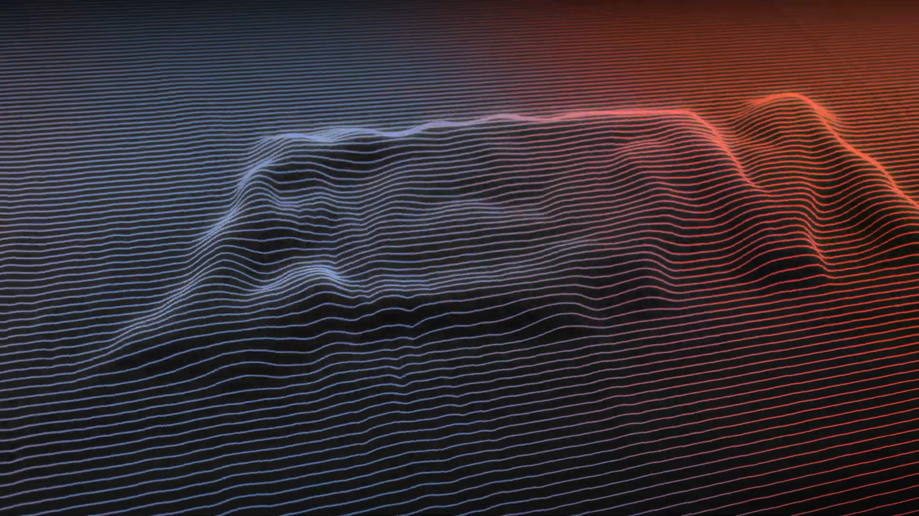
Notes:
BMW i4 M50 from Hans Zimmer

Slide 4
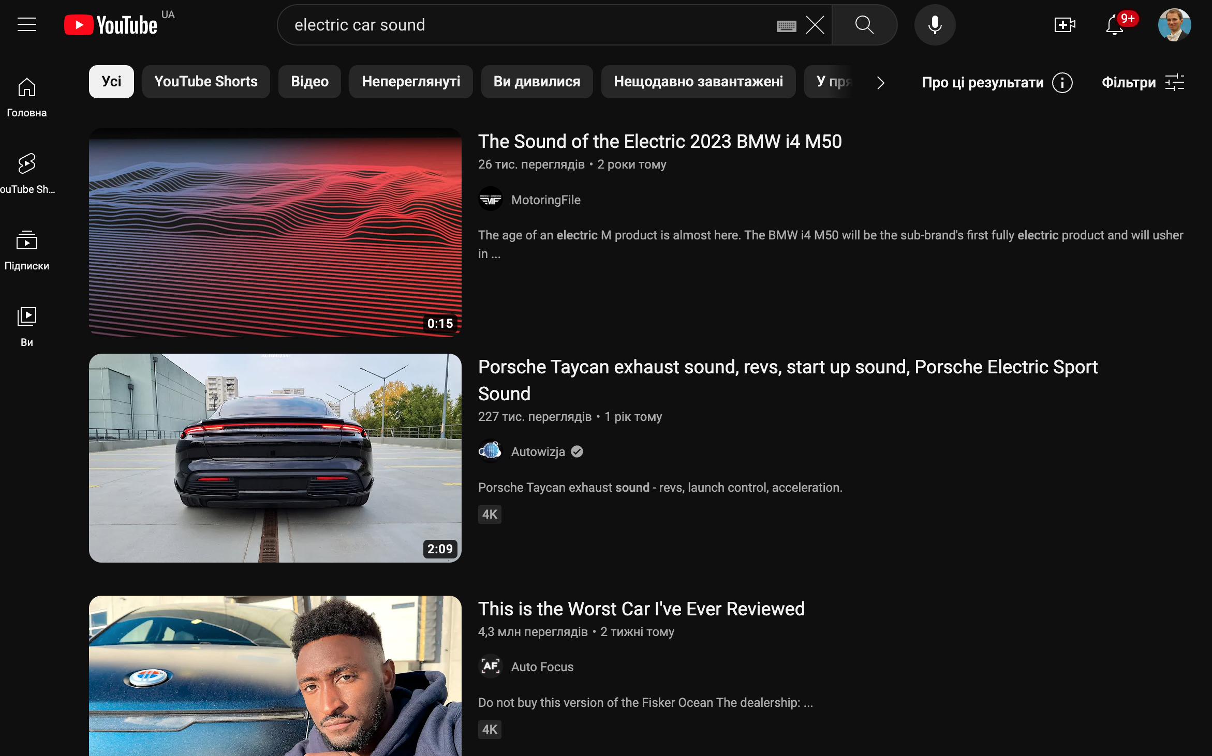

Slide 5
Challenge for today
How EVs should sound in the future?
Safe?
Noticeable by others (pedestrians)?
Not annoying?
Demonstrator:
Something that makes sounds and gives an idea of what happens with an EV with such a sound drives by pedestrian(s).
Be creative. And have fun!
10 min per group.

Slide 6
Where to start?
Videos on YouTube with current cars:
What is wrong?
Pure data (https://puredata.info):
Example of continuous feedback: https://bazilinskyy.github.io/publications/bazilinskyy2019continuous.
SQAT toolbox for MATLAB:
Greco, G. F., Merino-Martinez, R., & Osses, A. (2023). SQAT: a sound quality analysis toolbox for MATLAB (v1.0). Zenodo. https://doi.org/10.5281/zenodo.7934710.
MoSQITo toolbox for Python: Green Forge Coop. MOSQITO [Computer software]. https://doi.org/10.5281/zenodo.5284054
Generative AI.

Slide 7
Organisers
Ebo Topics: Software Engineering, Artificial Intelligence, Precision Agriculture
Skills: Python, ReactJS, PHP, JavaScript, SQL
Pavlo
Topics: automated driving, human factors, (some) acoustics, human factors crowdsourcing
Skills: python, jQuery, bootstrap, (some) Matlab, (some) pure data
Roberto Topics: aeroacoustics, signal processing, psychoacoustics, aircraft noise
Skills: MATLAB (SQAT)

Slide 8
Schedule
09:00–09:15 Introduction, coffee is served. 09:15–12:00 Hacking. 12:00–13:00 Lunch. 13:00–14:00 Hacking. 14:00 Coffee is served. 14:00–15:30 Hacking. Work stops at 15:30. 15:30–15:45 Break. 15:45–17:00 Presentations of demonstrators, awards, conclusions. 17:00-18:00 Borrel and networking

Slide 9
Sending your work
Upload your code to GitHub in a public repo.
Send us your files before 15:45:
demonstrator (whatever that is: sound files, video, unity executable, etc)
txt file with a link to the repo
Whatever else you think is useful for us to judge your work.
Send everything by https://wetransfer.com.

Slide 10
